Slide 1

Research Methods
Lecture 5 - Data collection and Sampling
Dr. Uma Mohan

Slide 2
Recollect this slide from the previous lecture
What is the difference between Research Methodology and Research Methods?
Methodology refers to- The theory of how research should be undertaken- philosophy and the processes of creating the knowledge, and
Methods refer to -The tools, techniques and procedures used to obtain and analyse data.
Key elements of the Research Methodology
Research philosophy
Research approach
Research strategy
Quantitative versus Qualitative (Design)
Research methods ( Data collection, Sampling and Data analysis)

Slide 3

Pilot Study
Before you start the data collection, it is advisable to do a Pilot study.
What is a Pilot study?
A collective term for -
Any small scale exploratory study that uses sampling but may be less rigorous or with an informal group

Slide 4
Selecting Methods for Data collection depends on
Consider the practicalities
Time
Resources
Confidentiality
Ethics
Sample
Is it the best method for my question?
Do I have the required skills?

Slide 5
Population & Sample (Intro)
We will see more in the Sampling Workshop
A sample is drawn from a defined population
Sample should accurately reflect the population
Types of sample:
Probability e.g. Simple random sample, Systematic random sample and Stratified random sample
Non-probability e.g. Convenience sample, Purposive sample and snowball sample
Now, we will see some of the Data collection methods in detail.

Slide 6


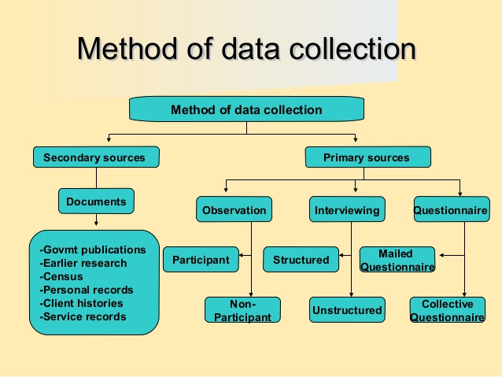
Overview of Data collection
Reference :
Maxwell, J.A., 2018. Collecting qualitative data: a realist approach. The SAGE handbook of qualitative data collection, pp.19-32.

Slide 7
Questionnaires
Used commonly in explanatory or descriptive research. Suitable in identifying and describing the variability in different phenomena.
It examines and explains relationship between variables (i.e. cause and effect relationships)
Not particularly suitable for exploratory studies that requires large numbers of open-ended questions

Slide 8
The Choice of Questionnaire
Self-completed questionnaire- internet mediated or web-based, intranet-mediated
Postal or mail questionnaires
Types of question you need to ask to collect your data (i.e. open-ended or close-ended questions)
Sample size and response rate needs to be considered here

Slide 9
Interviews
“Often presented as virtually the ‘gold standard’ of qualitative research (Barbour, 2003), interviews nevertheless involve a somewhat rarified, in-depth exchange between researcher and researched” (Barbour, 2008:113).

Slide 10
Three main types of Interview
Structured
predetermined questions
Unstructured
Use broad, open-ended questions to begin and prompts
Useful when little know about area of study
Semi-structured
set of topics/questions, which can be modified (interview guide)
More focused
Process can vary

Slide 11
Focus Groups
A group interview that focuses on a particular issue, product or topic by encouraging discussion among participants (Krueger and Casey, 2009)
The need for a skilled facilitator or moderator
Number of focus groups? Size of focus groups?
Advantages?
Disadvantages?

Slide 12
Group Composition
5 to 8 ( even 10 sometimes) people
Relatively homogeneous
Similar lifestyles and experiences
Permits data collection from a cross section of people in a relatively short time

Slide 13
Advantages of Online Focus Groups
Fast
Inexpensive
Bring together many participants from wide-spread geographical areas
Respondent anonymity
Transcript automatically recorded

Slide 14
Disadvantages of Online Focus Groups
Less group interaction
Absence of tactile stimulation
Absence of facial expression and body language
Moderator’s job is different

Slide 15
Observation
Structured/unstructured
Participant- covert or overt
Structured Observation:
involves systematically observing the behavior of individuals in terms of a schedule of categories
Frequency of actions and mostly quantitative

Slide 16
Participant Observation
Different methods of observation are -
Complete participant
Part of setting, insider role, often covert, ethical?
Participant as observer
Part of the work group under study, access?
Observer as participant
Marginal involvement, role clear
Complete observer
‘fly on the wall’ approach, descriptive, focused, selective

Slide 17
Observation
It implies intense researcher involvement in the day-to-day running of an organisation. An insider’s view. Used synonymously with Participant observation.
Issues to consider- Access, should it be covert or overt?
Advantages of a covert approach- easy access, reduced reactivity
Disadvantages of a covert approach- Anxiety, ethical problems etc.

Slide 18
Delphi Technique
This is extra material ( Not required at Level 5)
This involves using a group of people who are either involved or interested in the research idea to generate and choose a more specific research idea (Robson, 2011)
Relies on a panel of experts who answer questionnaires in two or more rounds.
Experts are encouraged to revise their earlier answers in light of the replies of other members of their panel until a consensus is reached.

Slide 19
Access and Ethics issues
Traditional access:
It involves face to face interactions, phone conversations or obtaining data not available online.
Physical access is important but could be difficult.
Do you need continuing access? ( duration of the access)
When do you need Traditional access? Rich research data

Slide 20
Access and Ethics issues
Internet-Mediated Access
Qualitative and quantitative data collection techniques are increasingly used via the internet.
It involves the use of different computing technologies to gain virtual access to administer questionnaires, conduct archival research or to gather secondary data (Saunders et al., 2012)
Selection is dependent on your research question and objectives.

Slide 21
Ethical considerations
Four major principles usually are:
Non-maleficence and beneficence
Autonomy
Justice and inclusiveness
Confidentiality and Anonymity

Slide 22
Summary
Consider the practicalities before choosing the method of data collection.
What will the best method to answer my research question?
The sample should be suitable for the study and know when to stop!
Make sure to think about how you will access the participants
Also remember to think of the possible ethical issues that may arise and address them carefully .

